Slide 1
Android Investigation
Brussels Technology Days
15 October 2014
Kristina Nordlander

Slide 2
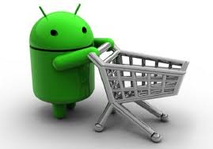
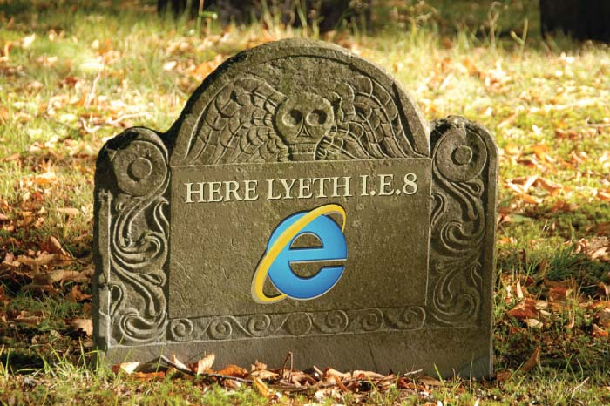
Could Play Store be dominant?
Play Store:
the most common and convenient way to browse and purchase Android-compatible apps
presumably high share of Android apps sold/downloaded through Play Store [no hard data]
Play Store is pre-installed on (most) Android devices and strongly supported by Google
Rings a bell? -----------→

Slide 3
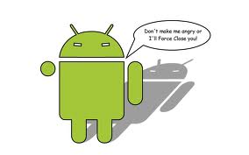
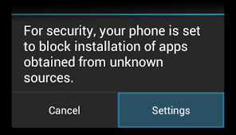
Aptoide complaint: “Google – we just don’t love you no more”
Play Store is (often) pre-installed: Aptoide CEO Paulo Trezentos: "They pay telecoms to ship phones with their search and now they start to bundle search and Play.“
Fully-functional third-party app stores cannot be listed in Play Store
Google has made it harder for users to install apps from third-parties
Aptoide store difficult to access: only 20% of users able to install Aptoide app (Aptoide’s experiment)
Can Google control (main) Android apps distribution channel?

Slide 4

Who is harmed?
App developers
Online payment services
Consumers
Arguably Android platform as a whole – less openness and innovation (“walled garden”)

Slide 5
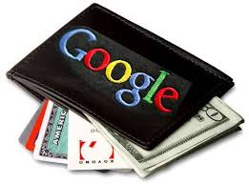
Play Store and Google Wallet
Google Wallet seems to be the only “authorized” payment method available in Play Store for in-app payments for digital goods
Apps and in-app purchases are likely to play a key role in driving the switch to digital mobile wallets
Gaining and maintaining access to Play Store: crucial for online payment systems in the shift from online commerce to mobile phone

Slide 6
Google Play Developer Program Policies
(current wording)
App purchases: Developers charging for apps and downloads from Google Play must do so by using Google Play's payment system.
In-app purchases:
  Developers offering virtual goods or currencies within a game downloaded from Google Play must use Google Play's in-app billing service as the method of payment.
  Developers offering additional content, services or functionality within another category of app downloaded from Google Play must use Google Play's in-app billing service as the method of payment, except:
    where payment is primarily for physical goods or services (e.g., buying movie tickets, or buying a publication where the price also includes a hard copy subscription); or
    where payment is for digital content or goods that may be consumed outside of the app itself (e.g., buying songs that can be played on other music players).

Slide 7

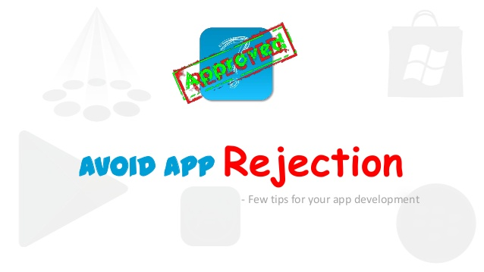

WILL I WAKE UP AND FIND MY APP PULLED?!
Upcoming SlideShare
Loading in...5
×
Google Tightens Up App Policy, Gets Stricter On Naming/Icon, Payments, Privacy, Ads And Spam Rules [Developer Letter]

