Slide 1
What is a Platform and should they be Regulated?
November 17th, 2015
Alfonso Lamadrid de Pablo alfonso.lamadrid@garrigues.com

Slide 2





Search on Garriwiki
The origin of the debate: political dissatisfaction
with competition rules
“We need a review of our competition law because the classical competition law is no longer adequate for what is taking place in society through digitalisation” (M. Machnig, German Sec. State at Econ. Ministry, 2014)
Doubts as to whether “the regulatory framework, especially on antitrust allows us to respond to abuse of dominance” (Axel Lemaire, French minister for Digital Affairs, 2014)
"We don't want to regulate the net…We want to regulate a small number of Internet platforms that today are blocking innovation from all of the other actors” (French minister for Digital Affaires Fleur Pellerin, 2013)
“We believe that the growing power of some digital platforms is a wider challenge that warrants a policy consultation with the aim of establishing an appropriate general regulatory framework for ‘essential digital platforms” (French economic minister Emmanuel Macron and German economic minister Sigmar Gabriel, 2015).
DSM strategy “the way they (´some platorms´) use their market power raises a number of issues that warrant further analysis beyond the application of competition law in specific cases”
Seemingly contrarian views of several MS (Letter to Tusk from GB, IR, SV, EST, PO, FL, CR, NL).
Notes:
The origin of the debate: political disatisfaction with competition rules

Slide 3

The inconsistent context of the debate
Search on Garriwiki
The inconsistencies of the debate
EU DSM Strategy aimed at “tearing down regulatory walls” but, at the same time….
Consultation on platforms (aimed at erecting new regulatory walls ?)
Consultation on collaborative economy partly aimed at addressing regulatory asymmetry, but at the same time…
Consultation on Platforms (aimed at creating regulatory asymmetry?)

Slide 4

What is a platform?

Slide 5




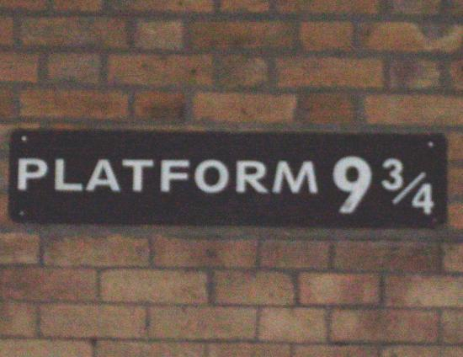

What is a platform?

Slide 6


Search on Garriwiki
What kind of animal?
The Law of the Horse Platform
The Blind Men and the Elephant Platform
“The blind are not good trail blazers” (Easterbrook in…“The Law of the Horse”)
A Bull Regulator in a China Shop

Slide 7
Should we change comp law?

Slide 8

Ask not what you can do to competition law, but what competition law can do for you!

Slide 9


WHY competition law can teach us
Search on Garriwiki
WHY Competition Law can teach us
WHY Competition Law can teach us
WHY Competition Law can teach us
Competition law is a legal distillation of common sense principles infused with sound economics
Ample and flexible drafting of main provisions + nature as judge-made law + apparent complexity= evolution in line with market realities and economics, free from inference of small politics (see Antitrust and the Political Center)
Enjoys privileged view of array of “platform”-related issues (often used to assess them)
Issues not discussed theoretically and in the abstract, but analyzed in specific cases in the light of evidence and market realities
Bottom-line: provides us with objective, technical, balanced, evidence-based non-dogmatic experience with regard to the functioning and virtues/perils of online platforms.

Slide 10
WHAT competition law can teach us
Search on Garriwiki
WHAT Competition Law can teach us
WHAT Competition Law can teach us (I)
1- Intervention/Remedies should follow clearly identified concerns and be proportionate- not to protect some competitors or achieve visions of how the market should work- Striving for perfection may make matters worse- When in doubt, don’t chill competition
2-Identification of “platforms”/ two-sided markets: Two-sidedness is a matter of degree, and is not exclusive to online settings
3-What matter are competitive constraints in markets, not the competing business models (online platforms might compete in same markets as non-platforms and offline platforms)
4-Appearances of market power in online settings sometimes not to be trusted (services provided for free, differentiation, multi-homing, switching, entry interoperability, etc)
5-The competitive reality of even “some platforms”- Assessment in the light of evidence
has not confirmed fears (e.g. Google/DoubleClick, Microsoft/Skype(?), Facebook/Whatsapp)

Slide 11
WHAT competition law can teach us
Search on Garriwiki
WHAT Competition Law can teach us (II)
WHAT Competition Law can teach us
6-Size/absence of rivalry does not necessarily matter (or is not necessarily a bad thing).
7- Competitive ambiguity of business practices carried out in multi-sided markets [see The double duality of two sided markets; same features that may yield market power might help achieve optimal scale/demand side efficiencies.
8-Competition law has shown that it is readily available when things go wrong [e.g. portability restrictions, interoperability denials, pricing restrictions, excessive pricing (MIFs), etc] and provides an example of flexibility/adaptability of the law to dynamic settings
9- Competition law isn’t the answer to everything (e.g. privacy/data protection?)
10- Competition is about consumer choice, much like public policy should be about enabling informed choices (educating consumers might be best way of protecting them).
If info is power, then give it to consumers!

