Slide 1


Neutrality & Public Competition Law
Jose-Luis Buendia
2nd Chillin’ Competition Conference, Brussels, 21 November 2016

Slide 2
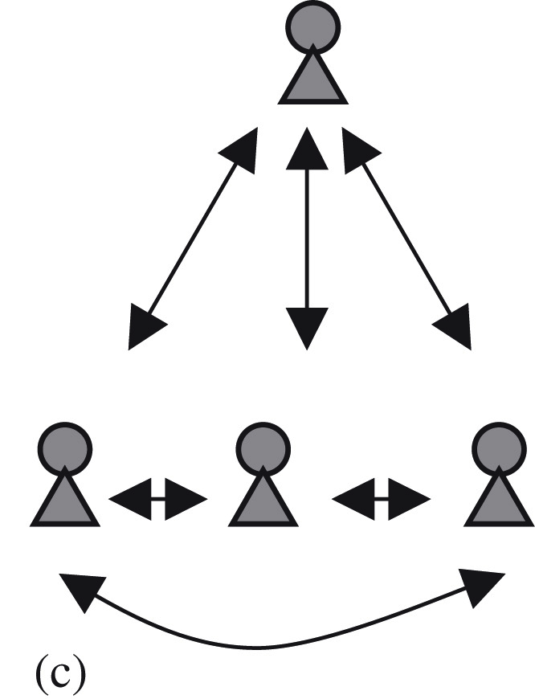
Back to basics
Emphasis on ‘neutrality’ comes from public competition law.
The role of ‘neutrality’ in competition law is different…
  In private competition law (antitrust and merger control)
  In public competition law (State aid, Article 106, SGEIs,…)
Different point of view:
  Private competition law: horizontal look at the competitors (‘level playing field’ )
  Public competition law: vertical relationship between the State and the competitors
By definition:
  Neutrality has always been a central notion in public (vertical) competition law (albeit not an absolute one).
  Neutrality has only played a subordinate role in private (horizontal) competition Law
Does it make sense to upgrade now the role of neutrality in private antitrust?

Slide 3
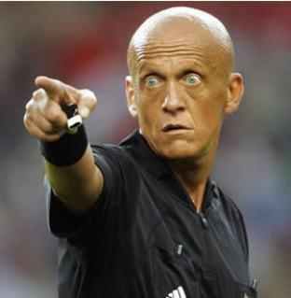
A Neutral Regulator
The State plays many roles (legislative, competition regulator, owner of undertakings,…)
The State has to be ‘neutral’ towards the different market players
  Article 106(2) TFEU “Undertakings entrusted with the operation of SGEI (…) shall be subject to the rules (…) on competition…”
But the State is not neutral between different policy choices
  Article 106(2) TFEU “… in so far as the application of such rules does not obstruct the performance (…) of the particular task assigned to them”.
So, even there, neutrality is not absolute:
  The State can grant (compatible) State aid agreed by EC
  The State can freely entrust SGEI to certain undertakings
  The State can own public undertakings (this is another meaning of ‘neutrality’ in EU Law).

Slide 4

Not a Blind Regulator
State aid law foresees a delicate balance between
  the freedom for the State to make legitimate policy choices
  and the need for ‘neutrality’ between market players.
Is this balance being made correctly?
Tax neutrality & Fiscal State aid cases
  State must treat equally all companies in a similar situation
  But it can offer them better treatment than in other countries
Technological Neutrality & Digital TV cases
  Do Member States have any discretion in the area of SGEI?
  Consistency across sectors?
The State is ‘neutral’ like a professor:
  It has to treat equally all the students (even to relatives)
  But it does not grant all of them the same mark.

Slide 5

Competitive Competitors
Are students supposed to be ‘neutral’ like the professor?
  Obviously not… unless we assume that some of them are now replacing the professor.
In antitrust: obvious tension between ‘competition’ and ‘neutrality’.
  Competitors are supposed to ‘compete’. They are not supposed to be ‘neutral’.
  Limits on competition are the exception (Article 102 TFEU).
  It not a ‘neutral competitor’ something close to an oxymoron?
Can we apply ‘neutrality’ requirements to (some) competitors?
  Are some big private undertakings becoming the SGEI of the XXI Century?
Problems:
  The State does not want to delegate a State function
  The undertaking does not want to become a SGEI
  Implicit recognition that the State is unable to properly regulate certain markets?

Slide 6
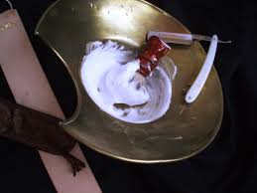

Neutral Competitors?
Both Neutrality and Competition are ‘politically correct’ words
  But there is an obvious tension between the two
  Need to understand the interaction between both
For that, need to look at the overall logic of EU Law
  In public competition law, neutrality has a central role but not at all an absolute one
  In private antitrust, neutrality may play a limited role but has to be subordinate to competition
If not, we may be creating some strange creatures

