Slide 1

CHILLIN’COMPETITION
CONFERENCE 2017
A year in review
(and in context)
Alfonso Lamadrid de Pablo
25 October 2017
Area42 – Brussels

Slide 2




















With many thanks to

Slide 3


Margrethe Vestager‏
Followed
@vestager
Excessive number of people in waitlist for #chillingcompetitionconf. People are angry. It is not fair.

Slide 4
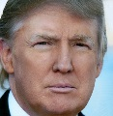
Margrethe Vestager‏
Followed
@vestager
Excessive number of people in waitlist for #chillingcompetitionconf. People are angry. It is not fair.
Donald J. Trump‏
Follow
@realDonaldTrump
Fake news media says I did not get a slot for the #chillingcompetitionconf. False covfefe! I didn't want to go anyway.

Slide 5
Margrethe Vestager‏
Followed
@vestager
Excessive number of people in waitlist for #chillingcompetitionconf. People are angry. It is not fair.
Donald J. Trump‏
Follow
@realDonaldTrump
Looking forward to #chillingcompetitionconf. Am told huge crowd this year, largest ever for antitrust even. Period. Blog's visits and attendees have skyrocketed since I am Precedent!

Slide 6
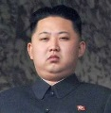
Margrethe Vestager‏
Followed
@vestager
Excessive number of people in waitlist for #chillingcompetitionconf. People are angry. It is not fair.
Donald J. Trump‏
Follow
@realDonaldTrump
Looking forward to #chillingcompetitionconf. Am told huge crowd this year, largest ever for antitrust even. Period. Blog's visits and attendees have skyrocketed since I am Precedent!
Kim Jong-un‏
Follow
@northKorean
@realDonaldTrump "skyrocketed" uh? ;)

Slide 7

chillin‘competition

Slide 8
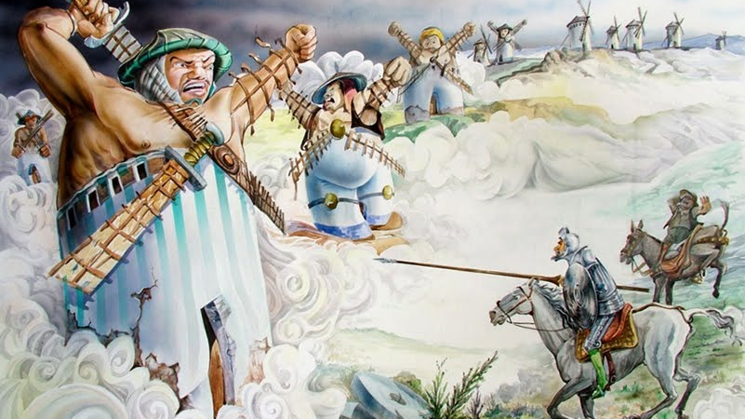

Slide 9
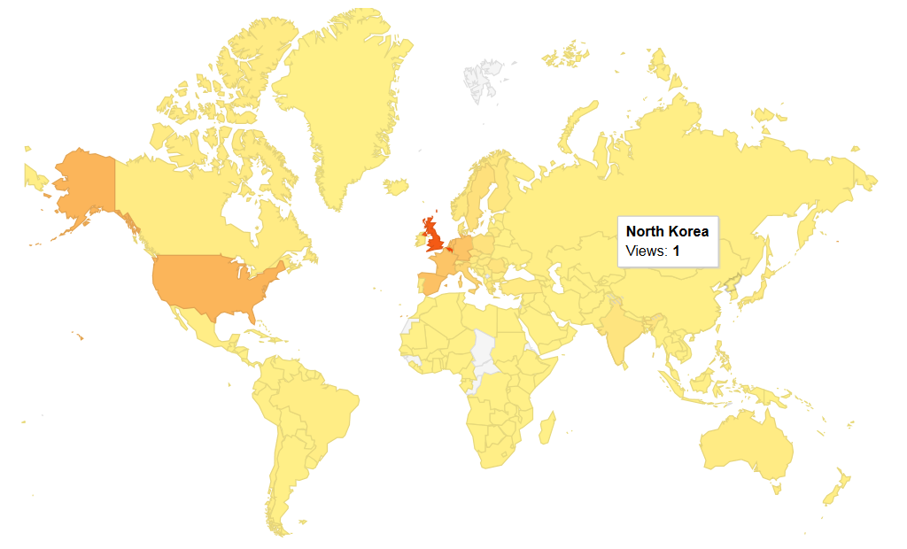
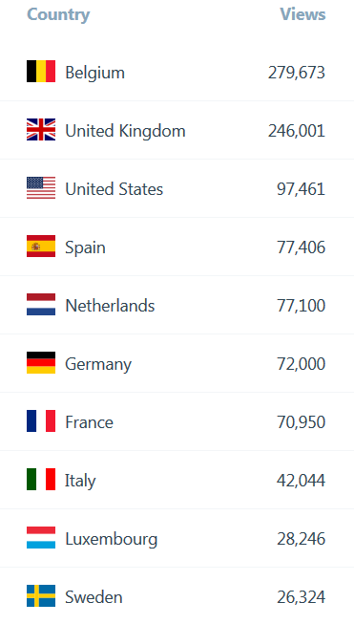

Slide 10
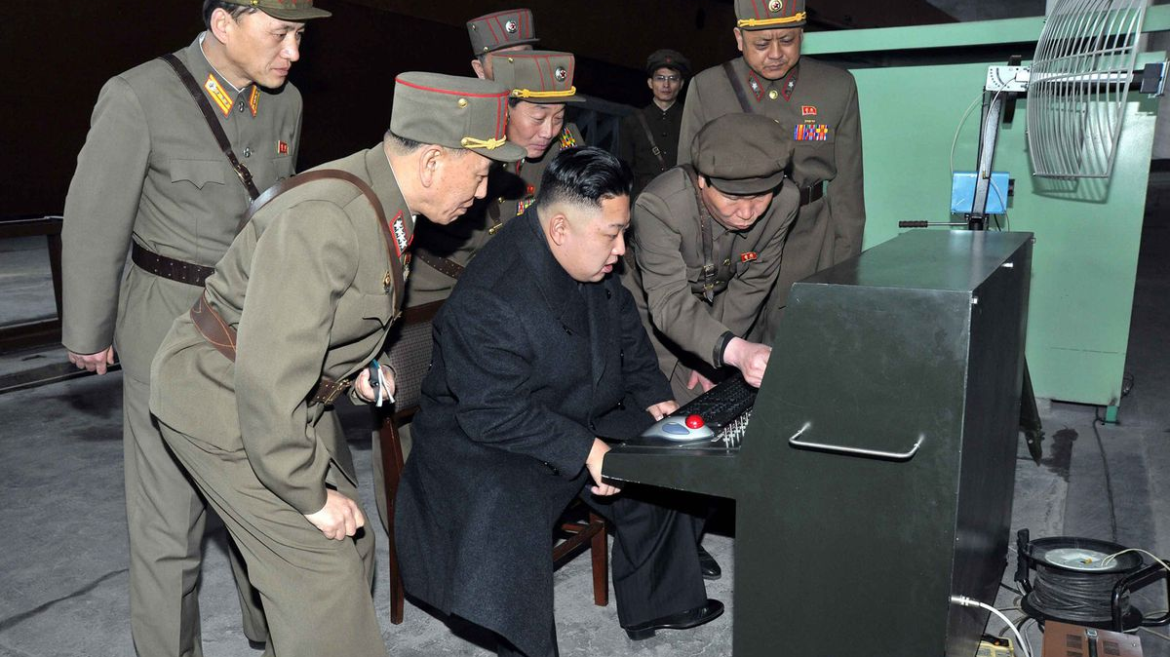

Slide 11

eggplants
brexit cooking recipes
penguin pictures
endives
absurd mkt. defs.
meme competition

Slide 12
Did we focus on the right questions in the past year?

Slide 13

does capability mean likelihood?

Slide 14
are exclusivity rebates by object infringements?

Slide 15
how can luxury perfumes be distributed in marketplaces?

Slide 16
how can we ensure that price comparison websites get traffic?

Slide 17

What did we learn in the past year?
There are formal and informal meetings
Excessive prices must be significantly and persistently about the competitive level
Acquisition of joint-control only falls within EMCR if “full functioning” JV
The Court does listen

Slide 18
What was the highlight of this year?
Intel Judgment
Google Shopping Decision
Chillin’Competition Meme Competition

Slide 19


Slide 20


