Slide 1
What you wanted to know about life in private practice but were too afraid to ask…
Jose Luis Buendia and Alfonso Lamadrid

Slide 2
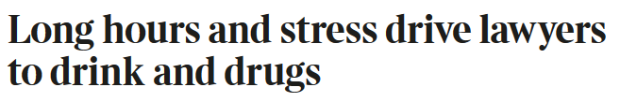
Typical headlines….
The Times, 6 October 2008

Slide 3

Typical headlines….
Business Insider, 12 November 2013

Slide 4

Typical headlines….
lawyerswithdepression.com, 16 November 2012

Slide 5
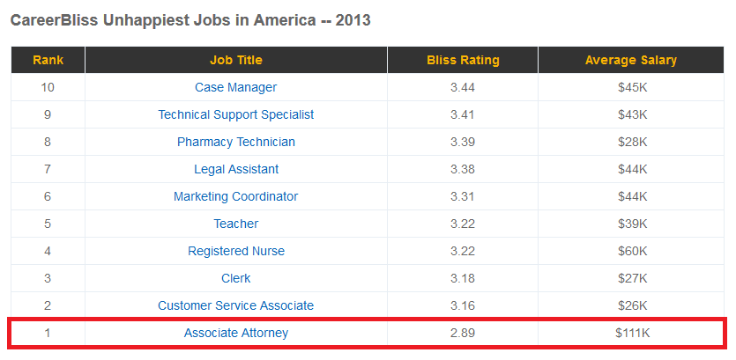
Typical headlines….
Careerbliss.com, 25 March 2013

Slide 6
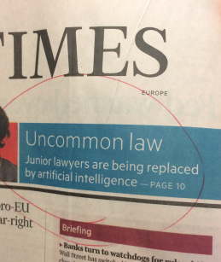
Typical headlines….
Financial Times, 4 May 2017

Slide 7
What you wanted to know about life in private practice but were too afraid to ask…

Slide 8
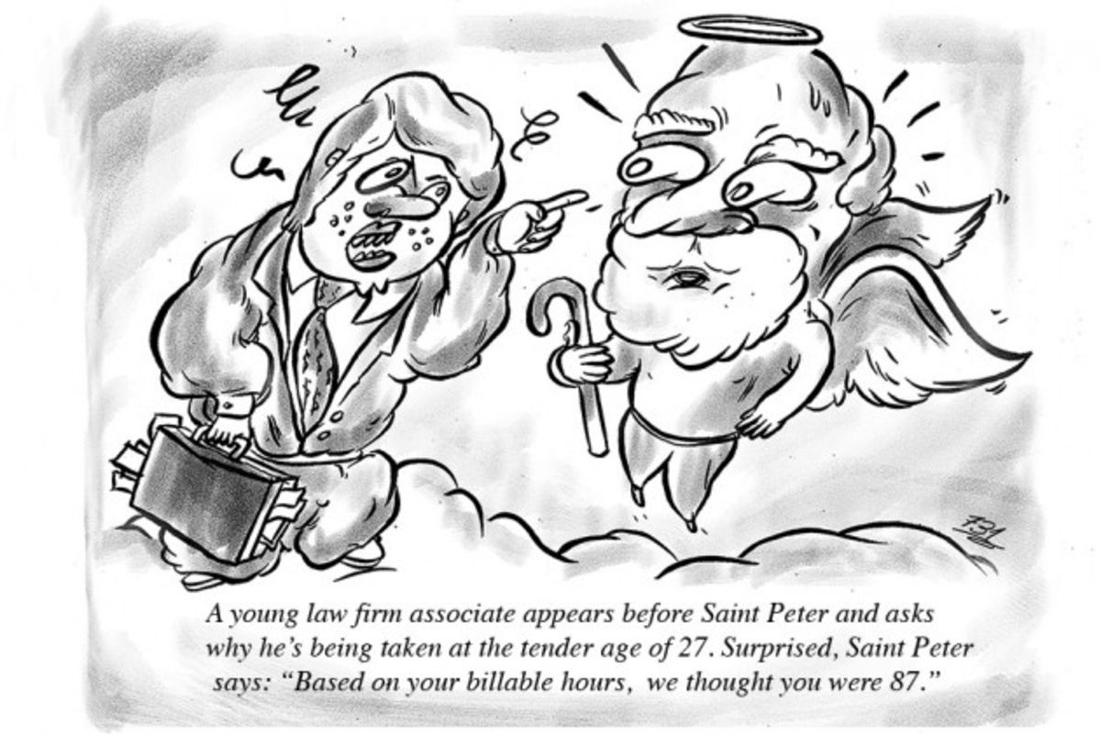
“Is it true that lawyers work 8 days per week?”

Slide 9

“Do lawyers have a life outside the office?!”

Slide 10

“Is there more to practicing competition law than excel sheets?”

Slide 11
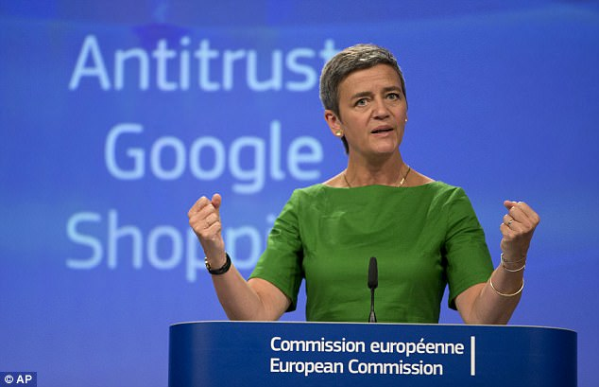
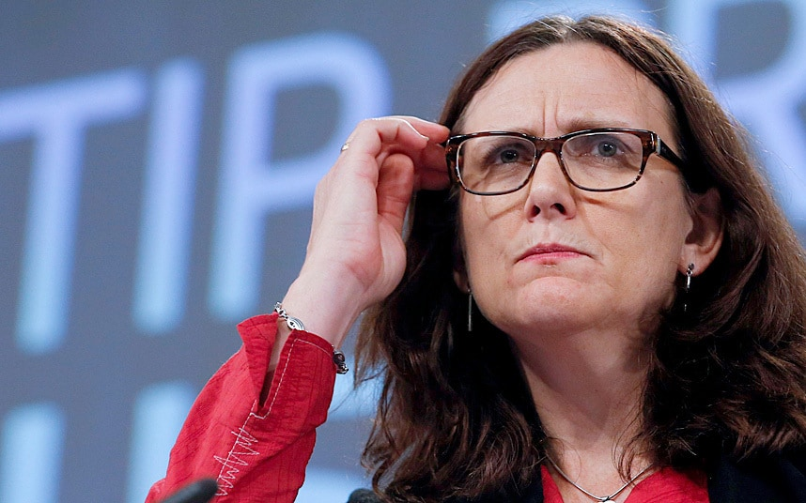
“Is the Brussels market only for competition lawyers – what about trade and EU regulatory?”

Slide 12
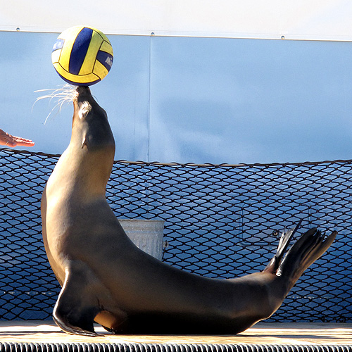
“What are the skills and attributes I need to be a successful lawyer?”

Slide 13
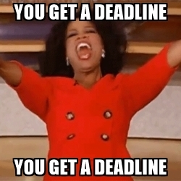
“How is work allocated within law firms?”

Slide 14
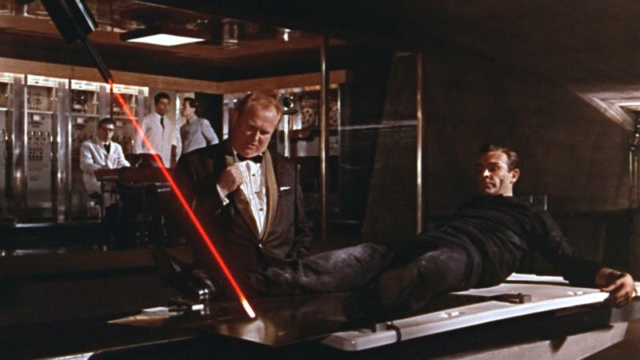
“How can I manage work peaks/stressful situations?”

Slide 15

“Is it true that the billable hour is king?”

Slide 16

“How are salaries at Brussels law firms? I hear that Belgian tax is a killer…”

Slide 17
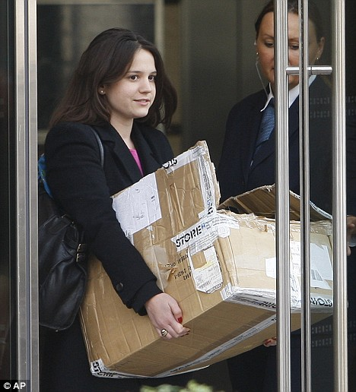
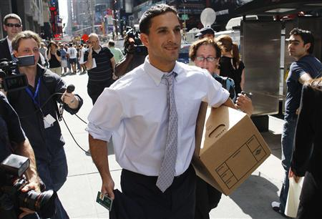
“What are the options for those who do not make it to Partner?”

Slide 18

“I want to see my name in CJEU judgments! What are the possibilities for pleading in Luxembourg?”

Slide 19

“What efforts do firms make to retain female talent?”

Slide 20

“How do I choose a law firm? They are all the same, right…?”

