Slide 1

The Burden of Proof
Dr Andriani Kalintiri
andriani.kalintiri@city.ac.uk

Slide 2
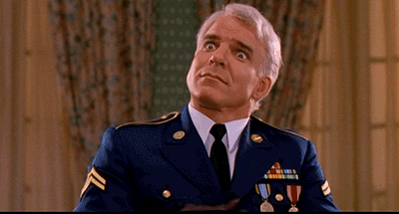

Slide 3
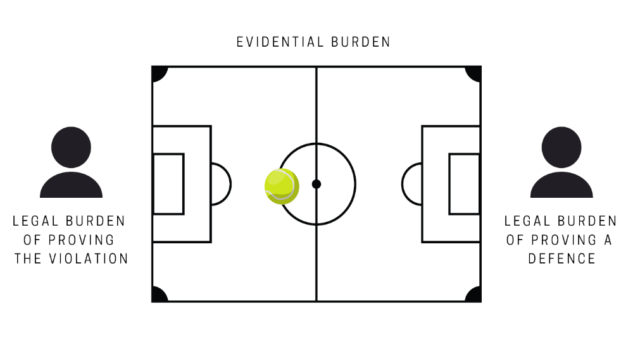

Slide 4
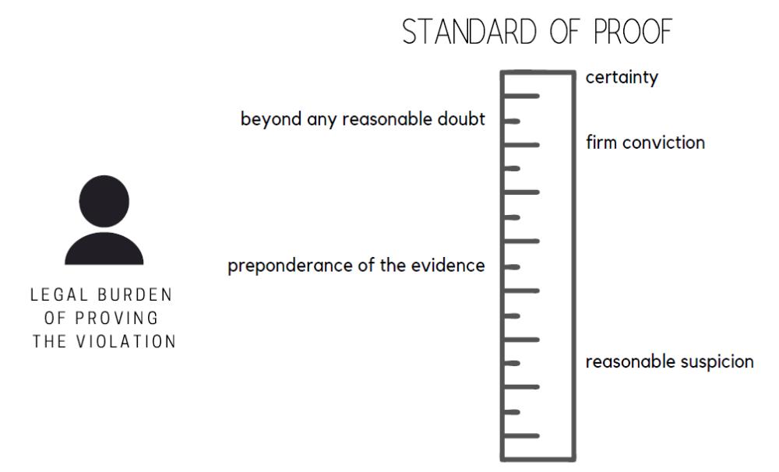

Slide 5
Basis | If A… | …B
Anic (ECLI:EU:C:1999:356) | If undertakings have communicated with each other and have subsequently remained active in the market… | …their market conduct has been informed by the content of their communications
Aalborg Portland (ECLI:EU:C:2004:6) | If an undertaking has attended an anticompetitive meeting… | …it has participated in the cartel
Dunlop (ECLI:EU:T:1994:79) | If there is evidence of anticompetitive instances sufficiently proximate in time… | …the infringement has continued uninterrupted in the period between
Akzo (ECLI:EU:C:2009:536) | If the parent company wholly owns a subsidiary… | …it exercises decisive influence over its market conduct

Slide 6
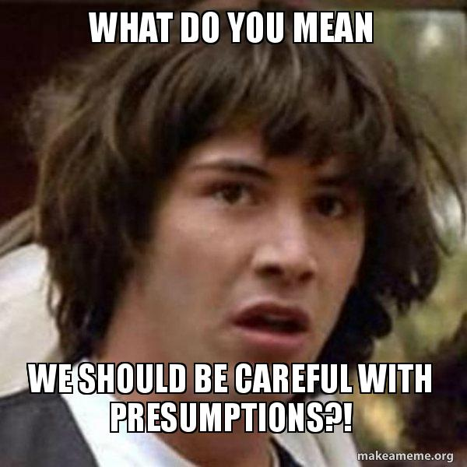

Slide 7
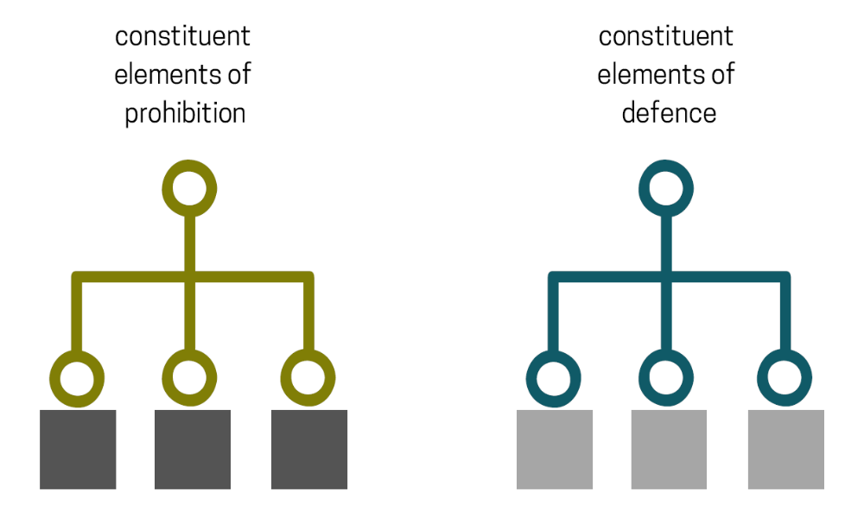

Slide 8
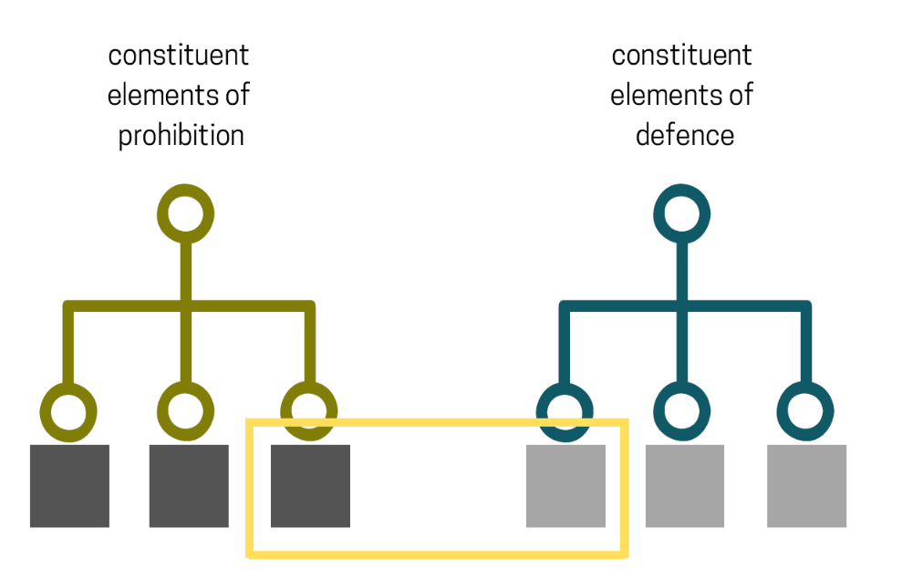
Restriction of competition/abuse of dominance
NOT a restriction of competition/abuse of dominance

