Slide 1


BSC MORNING BRIEFING:
The ECJ's Judgments in the cement case and their impact on future requests for information

Slide 2
contents
FACTUAL BACKGROUND
THE LEGAL ISSUES AT STAKE
THE LEGAL FRAMEWORK
GENERAL COURT JUDGMENTS
ADVOCATE GENERAL OPINIONs
ECJ JUDGMENTS
CONCLUSIONS

Slide 3
1. Factual background

Slide 4
1. Factual background
2008 & 2009: Commission conducts cement company inspections
December 2010: Commission decision to initiate proceedings
March 2011: Commission decision requesting information under Art. 18 Reg. 1/2003
  107 pages in length, including 67 pg. questionnaire, with several 100s of questions and sub-questions in relation to, literally, millions of data
  Reply within 12 weeks; requested extensions not granted (apart from one after appeal was lodged)
  Appeals lodged against RFI
29 July 2011: General Court order rejecting request for interim measures
14 March 2015: General Court judgments (T-292/11, T-293/11, T-296/11, T-297/11, T-302/11, T-305/11 and T-306/11)
31 July 2015:Closure of investigation
15 October 2015: AG Wahl opinions
10 March 2016: ECJ judgments

Slide 5
2. The legal issues at stake

Slide 6
2. The legal issues at stake
  “What are the conditions for, and limits to, the Commission’s power to require, by way of decision, undertakings to supply information in the context of investigation relating to possible breaches of EU competition rules?”
  Opinion of AG Wahl, para. 1

Slide 7
2. The legal issues at stake
“The Court confirmed that it is for the Commission to decide what information it considers necessary to request from companies when investigating potential anticompetitive practices”
Commission press release of 14 March 2014,
following GC judgment
“the implications of the judgments are likely to be confined to the present case, as the ECJ pronounced itself only on the issue of reasoning”
Commission spokesman, 31 July 2015,
following ECJ judgment

Slide 8
3. The legal framework

Slide 9
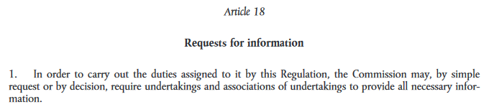
3. The legal framework

Slide 10

3. The legal framework
“Although the Commission is not required to communicate to the addressee of a decision ordering an investigation all the information at its disposal concerning the presumed infringements, or to make a precise legal analysis of those infringements, it must none the less clearly indicate the presumed facts which it intends to investigate.”
Hoechst AG v Commission (c-46/87 & c-227/88),
para. 41
“…in a decision ordering an investigation, the Commission must ‘clearly indicate the presumed facts which it intends to investigate’. This serves to ensure that the Commission does not carry out investigations on a speculative basis, without having any concrete suspicions, a practice for which the English term ‘fishing expeditions’ is often used.”
Opinion of AG Kokott in Solvay SA v Commission (c‑109/10 p),
para. 138

Slide 11
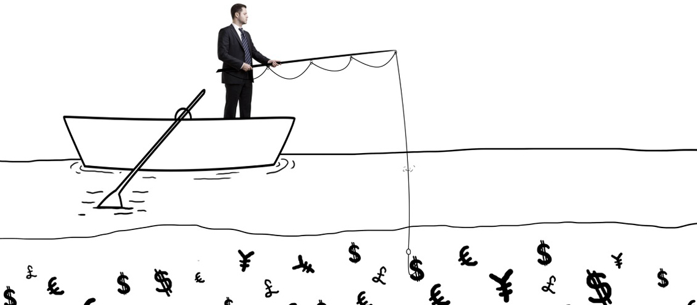
3. The legal framework
Prysmian (T-140/09) and Nexans (T-135/09) - rendered after written phase
“it is not enough for the information requested to be connected with the subject-matter of the inquiry. What is also necessary is that an obligation imposed on an undertaking to supply an item of information should not constitute a burden on that undertaking which is disproportionate to the requirements of the inquiry”
SEP v Commission (T-39/90) para. 51

Slide 12
4. general court judgments

Slide 13
4. General court judgments
Most companies alleged in their appeals that the RFI lacked a proper statement of reasons and that it was not proportional.
In those cases the GC ruled (T-292/11, T-293/11, T-297/11, T-302/11, T-305/11 & T-306/11):
  that although it is true that “the presumed infringements [were] set out in very general terms which might well have been made more precise”, they have the minimum degree of clarity in order to be able to be considered to be consistent with the requirements of EU law; and
  that even if “the size of the workload caused by the volume of information and the very high degree of precision in the response format imposed by the Commission cannot be reasonably disputed”, that workload was not disproportionate in the light of the necessities of the enquiry and the extent of the presumed infringements.
The content of the Judgment in the seventh case (T-296/11) is different….

Slide 14
4. General court judgments
In case T-296/11 (Cementos Portland Valderrivas) the General Court stated:
  Even though Commission not obliged to disclose to companies preliminary evidence at its disposal, must have enough evidence to justify the information request (paras. 38-40)
  It accepted that we had “put forward factors capable of casting doubt on the sufficiently serious nature of the evidence concerned” → requested Commission to produce a summary of its file (paras. 23-26)
  On the facts: the light of Commission’s file, the latter could have validly addressed the exhaustive (and exhausting!) RFI to the applicant.
    Even if applicant did offer alternative interpretation of elements in file, Commission cannot be asked at preliminary stage to have evidence so consistent as to be sufficient to establish an infringement (para. 59)
    Enough to have evidence that—at preliminary stage and absent third party contextualization—would have aroused reasonable suspicion.

Slide 15
5. Advocate general OPINIONS

Slide 16
5. Advocate general opinionS ( I )
Statement of reasons
  Observes that even GC acknowledged it was succinct
  Flexible: Can be implied/indirectly found in context and questions asked, but no connecting thread to be found given number and variety of questions
  If intention was to do whole mapping of companies activities to process with econ. tools then doubtful that appropriate under Art. 18.
  Early vs. advanced stage of investigation
Necessity (Heidelberg, paras. 70-93)
  “the criterion of “necessity” of information is to be assessed in the light of the indicia at the Commission’s disposal, and “failing any concrete indicia constituting reasonable grounds for suspicion, the adoption of an [RFI] may be considered to be an arbitrary measure of investigation”
  the existence and sufficiency of indicia can be subject to judicial review → “Commission may be required to disclose the evidence on which it based its grounds for suspicion” (cites T-296/11, Cementos Portland)
  GC wrong to consider that “necessity” is satisfied when there is a connection between the info requested and the presumed infringement

Slide 17
5. Advocate general opinionS ( II )
Proportionality and others
  Can the EC require information to be provided in a given specific format?
  AG’s balanced take: cannot provide info in a “chaotic, unsystematic or fragmented manner”, but limit is not forcing them “to complete tasks which belong to the building of a case” by the Commission’s staff.
  Reasonable time-limits to respond? Means available to the undertaking relevant.
  Vagueness of questions?
    AG criticizes the GC´s finding that the “relative vagueness” of some questions could not be considered a violation of the principle of legal certainty, but relevant in reviewing decision imposing a fine for supplying a vague answer. GC should have reasoning for (i) annulled the specific questions it thought were vague and; (ii) identify which were those questions and why they were vague.
  Self-incrimination: questions that are purely factual can also, in certain circumstances, breach the right against self-incrimination

Slide 18
6. JudgmentS of the ECJ

Slide 19

6. JudgmentS of the ecj
ECJ’s ruling confined to statement of reasons (due to procedural economy reasons; only plea common to all appeals)
  Since the Commission did not clearly indicate the “subject of its investigation“, ”alleged infringements“ or ”suspicions that it intends to investigate“, the parties and the Commission were not in a position to determine whether that information was “necessary” in the sense of Art 18 of Regulation 1/2003.
  The fact that ECJ did not rule with regard to other pleas should not obscure their relevance;
  Unclear on necessity test (e.g. paras. 24- 27 Heidelberg)
  Even if not definitevely settled, the case (notably AG) has shed useful light;
  Implications of the case wider than ECJ’s ruling, and likely to influence future enforcement

